Slide 1

CUSTOMER BEHAVIOR PREDICTION
2/12/2025

Slide 2
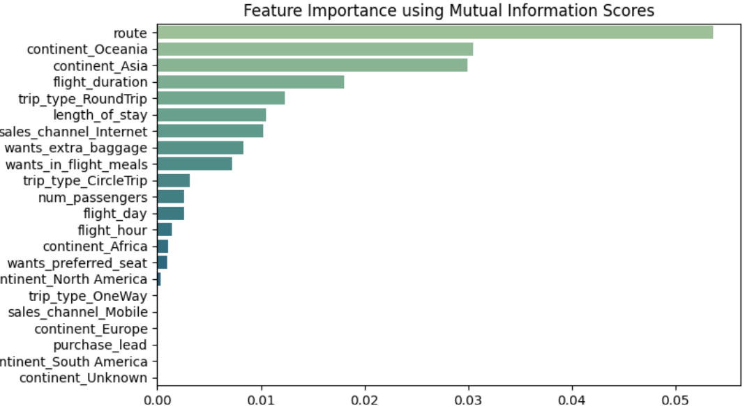
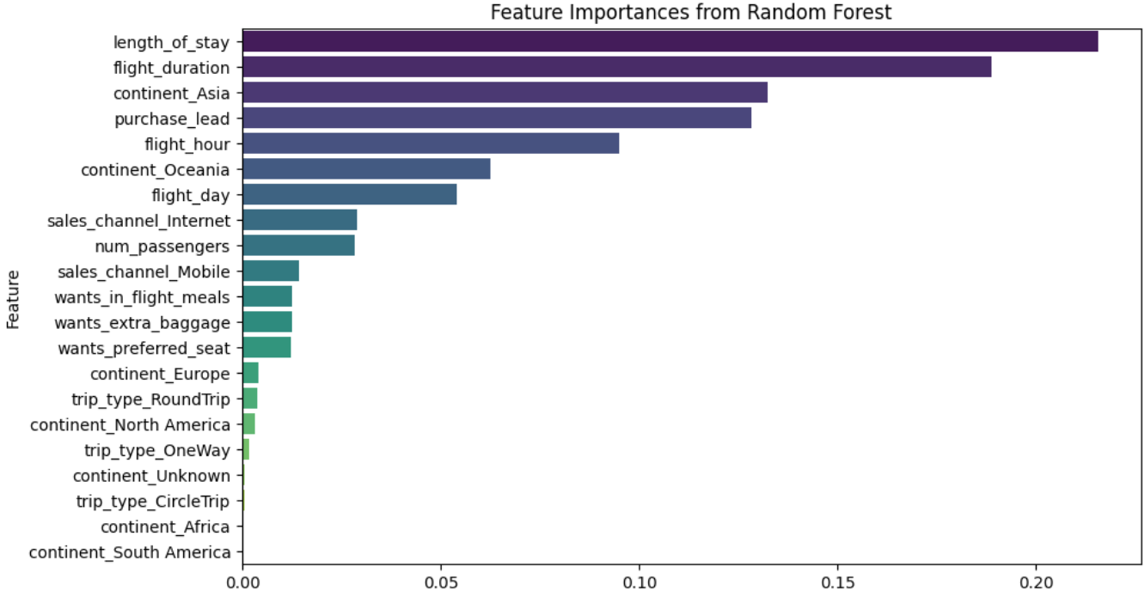
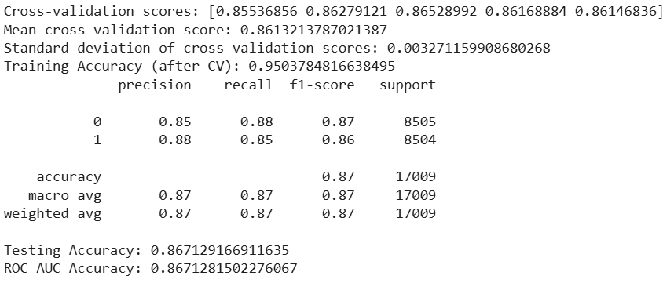
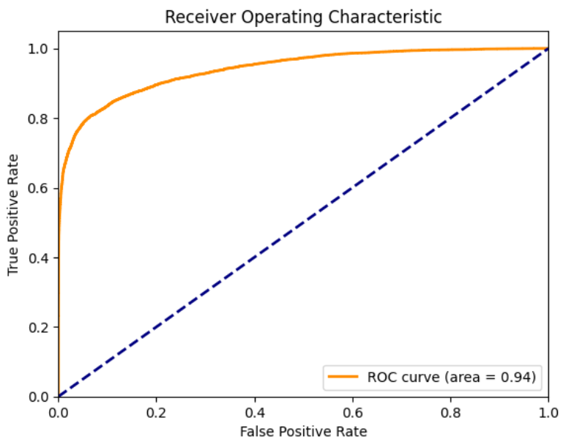
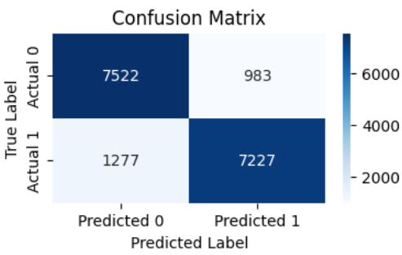
INSIGHTS
TOP 6 Factors for that affect Customer Booking completion :
Route
Continent_Oceania
Continent_Asia
TOP 6 Factors for that affect Customer Booking completion, when route is not considered:
Length_of_stay
Flight_Duration
Continent_Asia
4. Flight_Duration
5. Trip_Type_RoundTrip
6. Length_of_stay
4. Purchase_Lead
5. Flight_hour
6. Continent_Oceania
RANDOM FOREST
RESULTS

